Slide 1
Environmental Benefits of Rain Barrels
Presentation made available by Michele Bakacs, Rutgers Cooperative Extension,
Environmental and Resource Management Agent, Middlesex and Union County
bakacs@njaes.rutgers.edu, (732)398-5274
Notes:
Hello and welcome to today’s presentation on rain barrels. This program was developed by Rutgers Cooperative Extension and based on the Clean Virginia Waterways Rain Barrel program.

Slide 2
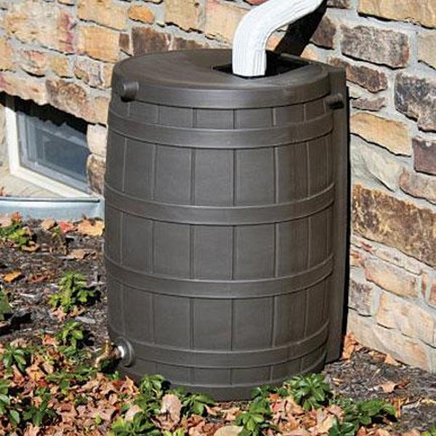
What is a Rain Barrel??
A water tank that collects and stores rain water runoff from a roof top via pipes (downspouts).

Slide 3
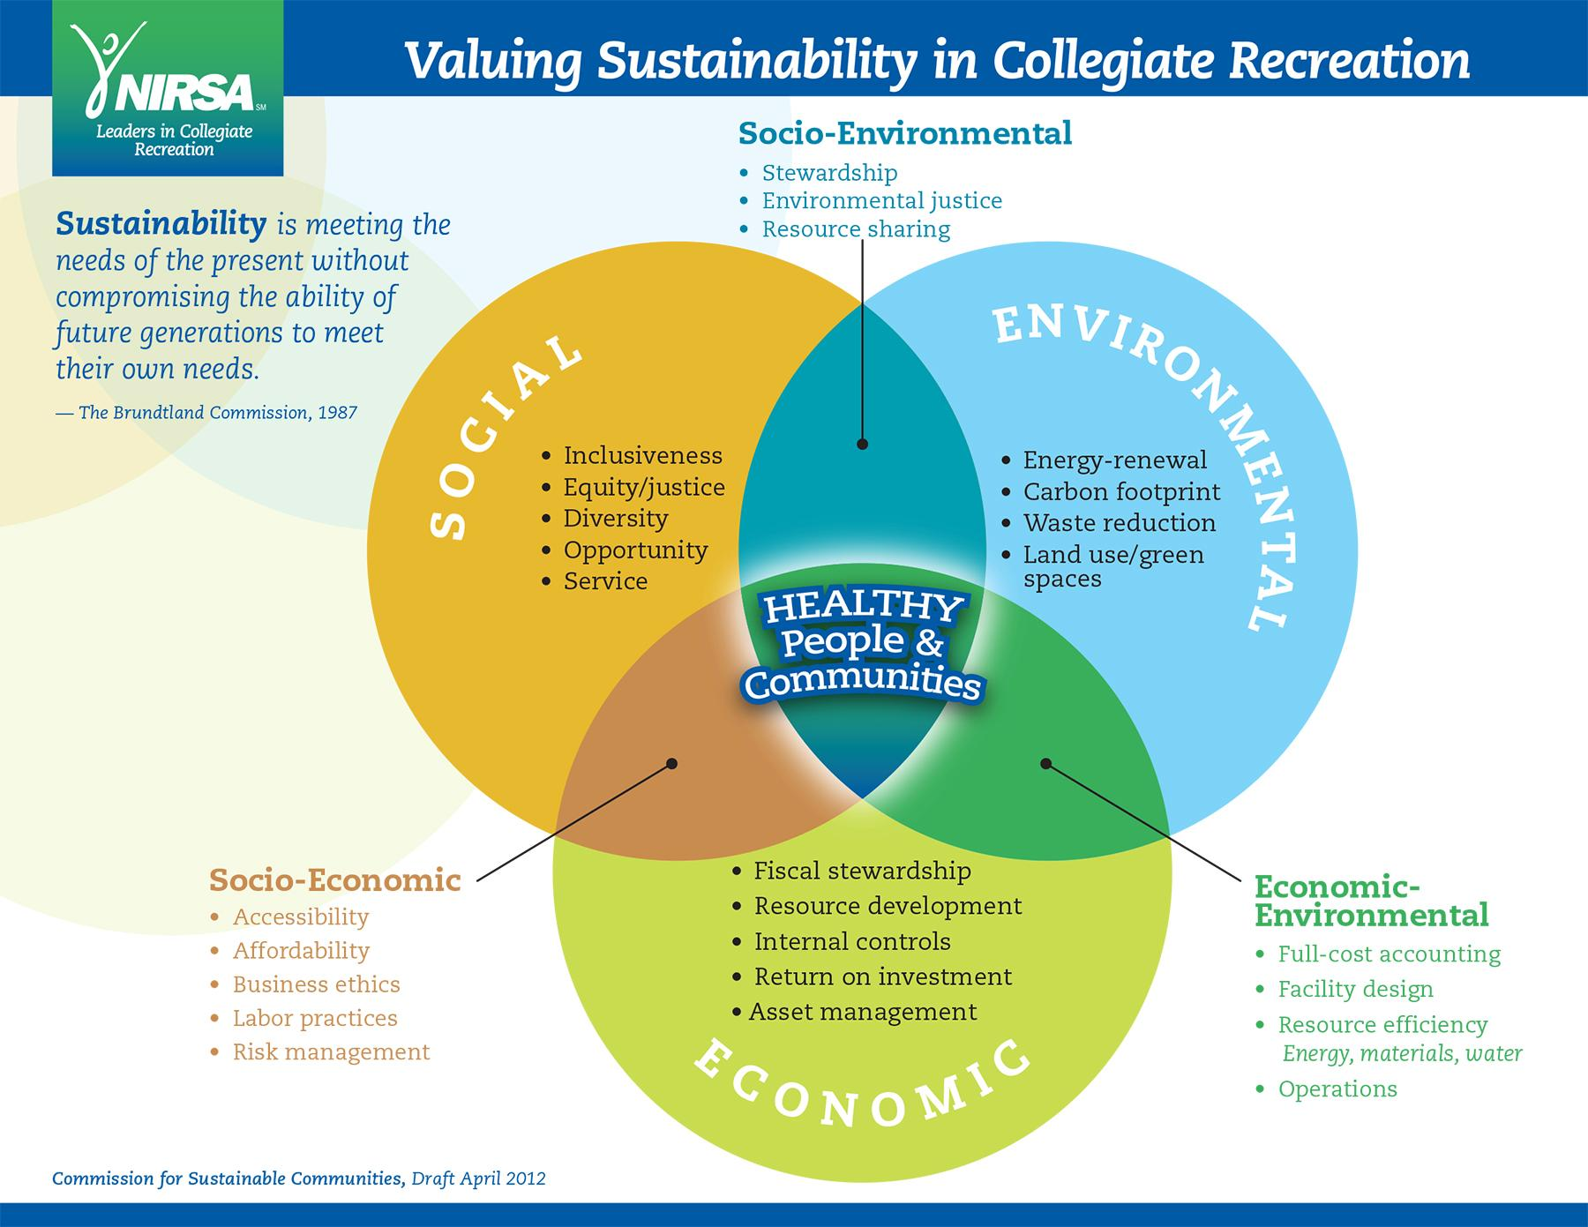
Why Rain Barrels?
Notes:
Kristen added this in herself, you don’t have to present this!
Rain barrels are part of a bigger picture of living in a manner that reduces the impact of your home on the environment - This is called sustainable living.
What is sustainability? It is a way of living to make sure that the resources we have now are still available for generations to come. There are three aspects to consider: social – making sure that everyone has access to the same resources, economic – making sure that the money you spend on resources is worth it, and environment – how we minimally impact it so those resources are shared by all life.
A rain barrel is sustainable because socially, anyone can physically do it – even if you live in an apartment, you just gotta convince your landlord or homeowners association to do it.
A rain barrel is sustainable because economically, you’re getting your money’s worth obtaining this rain barrel today and saving money on your water bill.
A rain barrel is sustainable because environmentally, you’re using this water on your lawn and garden, which will allow the water to infiltrate into the ground and recharge our freshwater aquifers.

Slide 4
Why Rain Barrels?
Part of a bigger picture of
Sustainable Living:
Water Conservation
Reducing Rain Water Runoff
Control Water Pollution
Notes:
Why are we promoting the use of rain barrels? Again, it’s part of a bigger picture of sustainable living.
By using a rain barrel you are conserving water, you are reducing rain water runoff (also called stormwater) from your property, and you are controlling water pollution.
First I will focus on how rain barrels help us save water.

Slide 5
How much water can you harvest?
Based on a Roof area of 800 ft² (40’ x 20’ )
1" rainfall event = 500 gallons
45" rainfall per year = 22,442 gallons
Photo by: SharkeyinColo
Notes:
You will be conserving water New Jersey seems like a water-rich state because on average we receive 45” of rainfall per year. But New Jersey’s population is growing making New Jersey vulnerable to future water supply shortages.
Our groundwater and fresh water supplies are limited. We all need to start adopting water saving practices at home to help prevent future water shortages.
So how much water can you collect in a rain barrel? Most people have no idea how much water comes off their roof. For a 800 square foot roof area, in a 1 inch rain storm (the average rain event in New Jersey is approximately 1 inches), 500 gallons of water will come off this roof. You would need about ten, 55 gallon barrels to collect all the water that came off this roof.
With 45 inches of rainfall per year, 22,442 gallons of water could be harvested from this roof.

Slide 6
How much water can you save?
One rain barrel will save about 1400 gallons from April through October
Notes:
One rain barrel will save about 1400 gallons of water from April through October.
A rain barrel will save most homeowners about 1,400 gallons from April through October. (Note to speaker: this number was calculated based on available precipitation data in New Brunswick, New Jersey, and based on the assumption that the barrel is drawn down after every rain event)

Slide 7
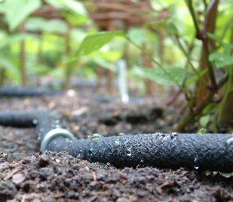
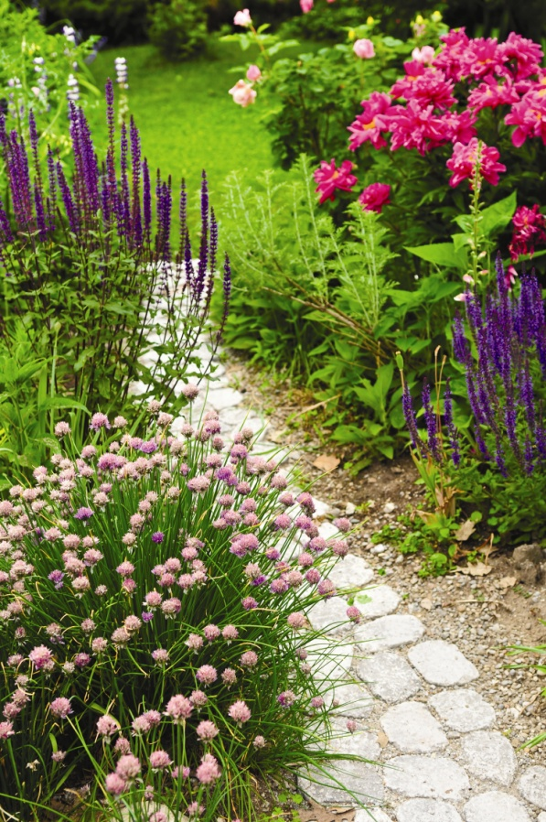
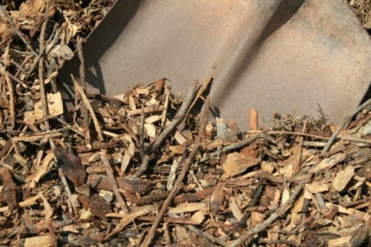
Other ways to save water
OUTDOORS
Adjust watering as conditions change
Use a rain gauge to determine
your watering needs
Native plants
Mulch around plants
Water early in the morning
Use soaker hoses – helps reduce
evaporation
Notes:
Besides using a rain barrel, there are both indoor and outdoor methods for saving water and money.
1. Don’t over water your lawn! You only need one inch of water on your lawn per week. If you use an automatic sprinkler system make sure to adjust it as conditions change.
2. Use native plants - plants indigenous to our region. They have evolved as part of New Jersey’s ecosystem. Need less fertilizer and are more adapted to drought conditions.
3. Mulch around garden plants - helps reduce evaporation from the soil
4. Water early in the morning when evaporation rates are lowest. Before the dew dries is ideal in order to reduce the amount of time your grass is wet and therefore vulnerable to disease and fungus.

Slide 8
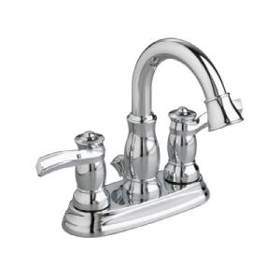
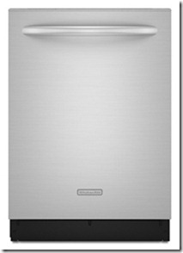
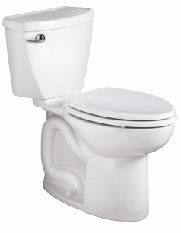
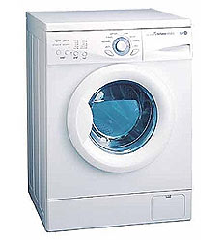
Other ways to save water
Indoors
Look for EPA WaterSense logo
WaterSense toilets (20% less water)
Energy efficient dishwashers and washing
machines (50% less water)
WaterSense showerheads (40% less water)
Faucet aerators
Notes:
There are many ways to save water indoors:
1. Look for the Environmental Protection Agency’s WaterSense logo when shopping for appliances. These are certified by the EPA as the most water efficient products on the market.
2. Toilets - By far the largest water user in the home - 30% of total water use. WaterSense toilets (1.28 gal/flush) use 20% less then federal standard of 1.6 gal/flush.
2. Washing machines - Front loading uses 10-20 gallons verses above 40 gallons of water from conventional.
3. Showerheads - EPA currently working on a maximum flow rate of 1.5 gpm compared to current standard of 2.5
Basically, what is important is that older appliances waste a lot of water and there are newer appliances on the market that can help save water and money.

Slide 9
Other ways to save water
When replacing fixtures and appliances look for:
You can also visit the USEPA website: www.epa.gov/WaterSense/ to learn more about this program and other water saving ideas.

Slide 10
Why Rain Barrels?
Part of a bigger picture of
Sustainable Living:
Water Conservation
Reducing Rain Water Runoff
Control Water Pollution
Notes:
Rain barrels also help us live sustainably by reducing rain water runoff (also called stormwater runoff) from our properties which reduces flooding in our communities
And by controlling water pollution to our local lakes, rivers, and streams.

Slide 11
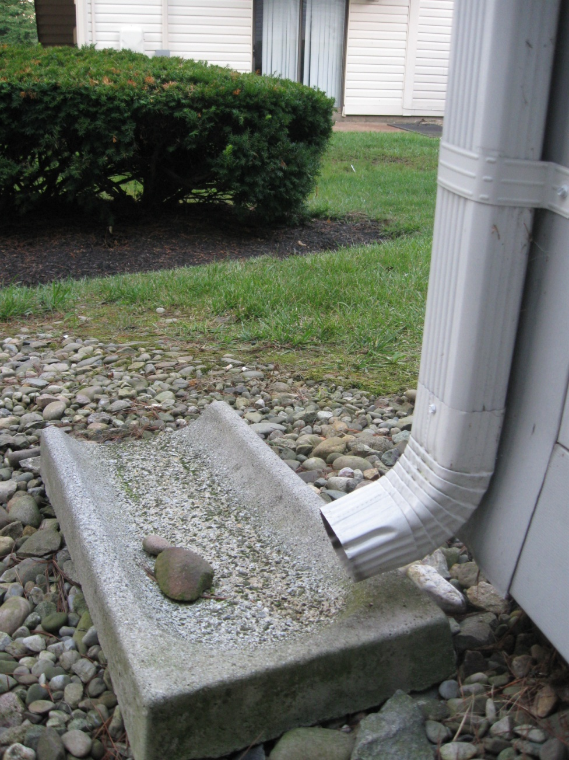
Reduce Rain Water Runoff
Notes:
If you go outside, look to see where the rain water goes from downspouts.
Maybe they go into the grass or a garden area where the water soaks into the ground. That’s good. That’s what we want. We want the rain water from our roof and other hard surfaces on our property to infiltrate into the ground and replenish groundwater.

Slide 12
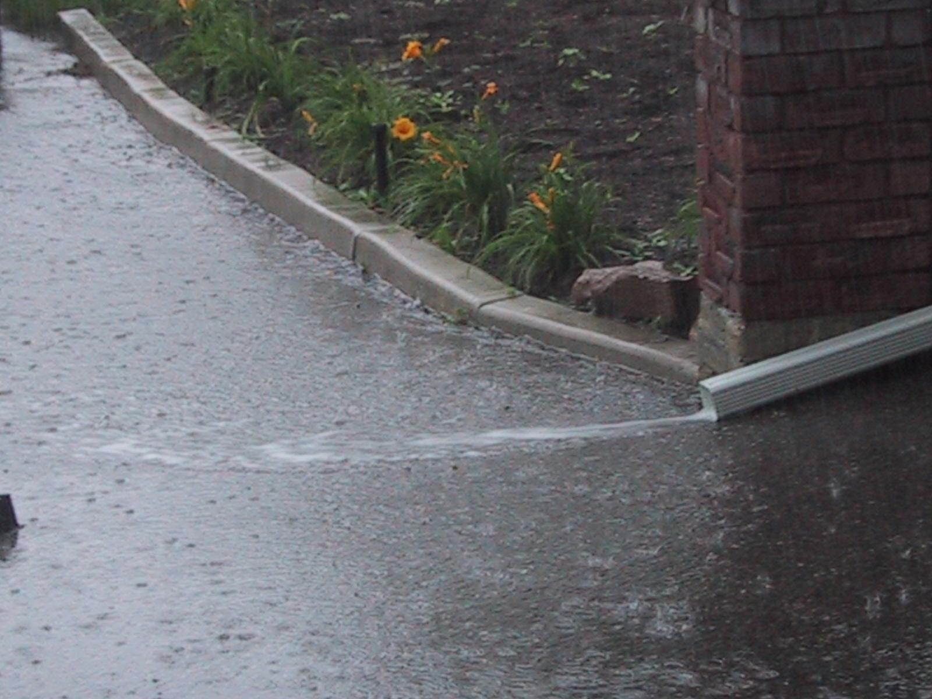
Reduce Rain Water Runoff
Notes:
…..But maybe your downspouts discharge to a hard surface like a driveway, onto the sidewalk and out onto the street like in this picture.

Slide 13
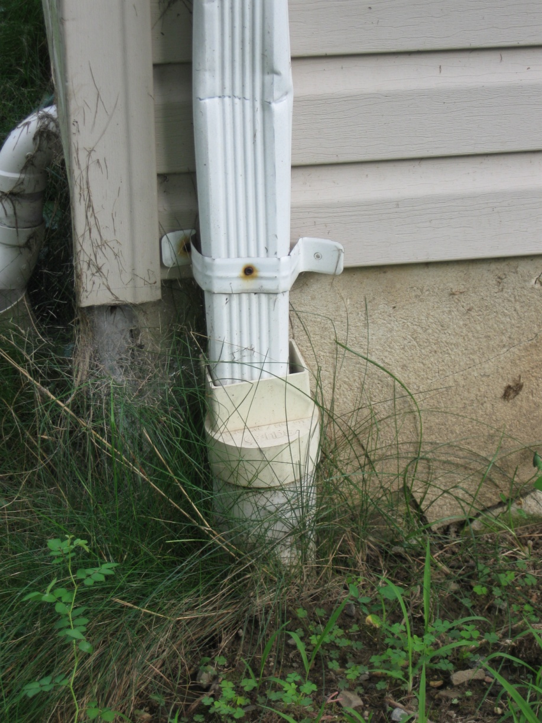
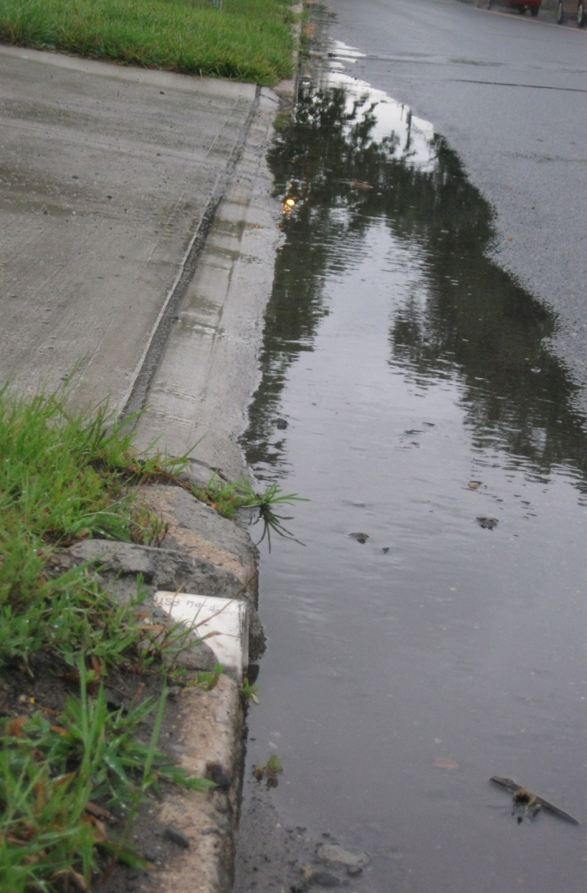
Reduce Rain Water Runoff
Notes:
Your downspout might also be directed underground through a pipe and then discarded directly onto a street or sidewalk

Slide 14
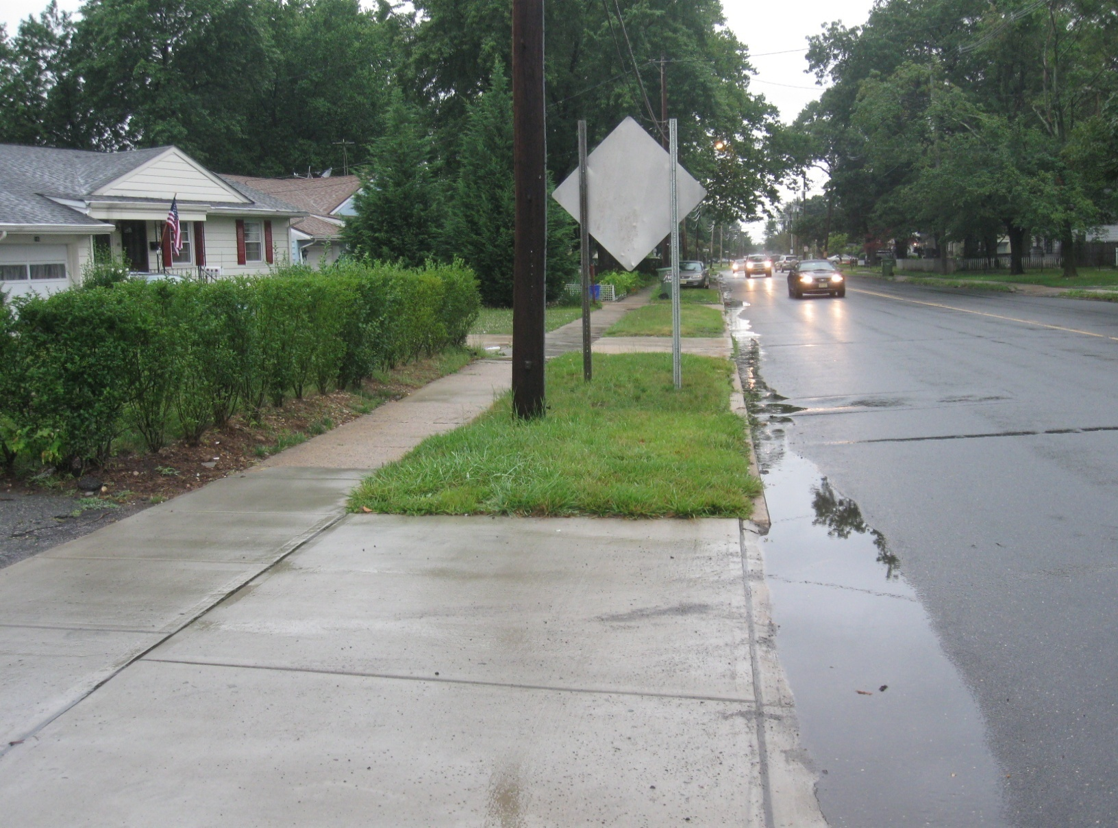
Notes:
When downspouts are discharges directly onto impervious cover it contributes to flooding because impervious surfaces cannot absorb water

Slide 15
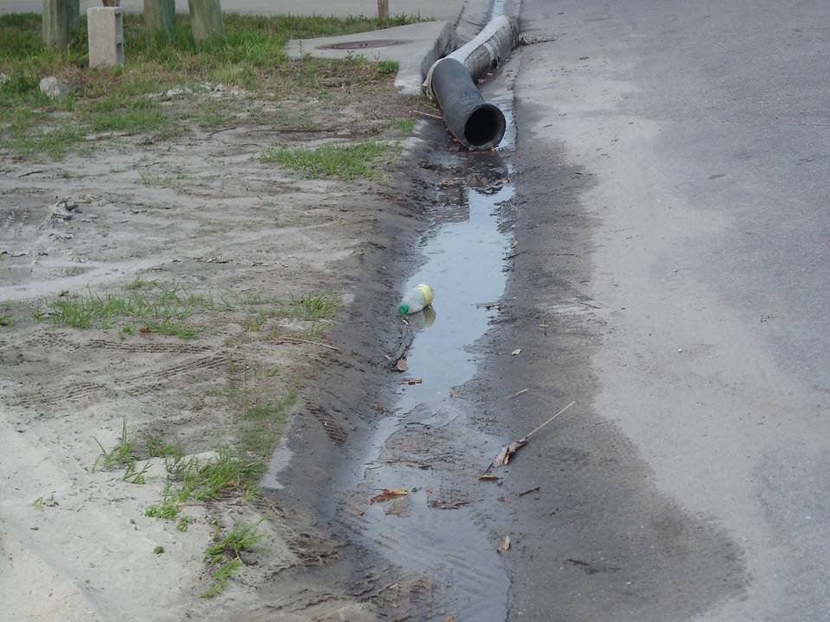
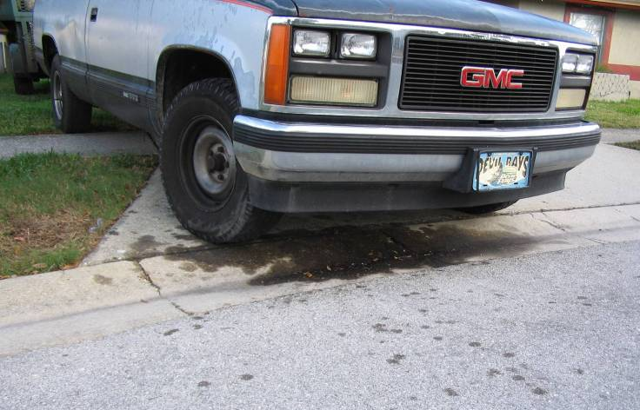
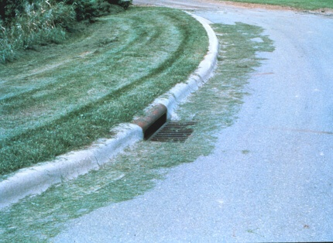
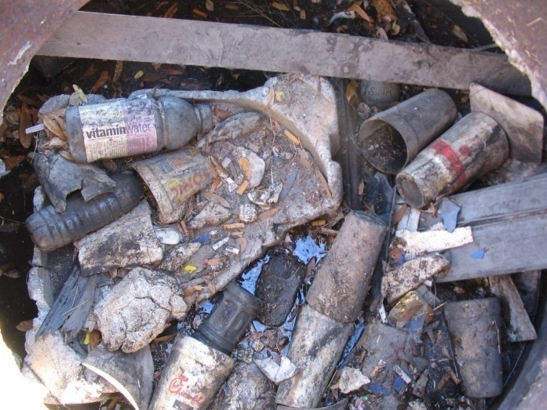
Control Non-Point Source Pollution (People Pollution!)
Pollutants – dirt, litter, pesticides, fertilizers, oil and grease, pathogens
Notes:
This also contributes to water pollution
Roadways accumulate dirt, litter, pesticides, fertilizers, oil and grease, pathogens.
These are NON-POINT source pollutants because once they get to the stream, we have no way of identifying their source
When it rains the water picks up these pollutants and carries them into water bodies

Slide 16
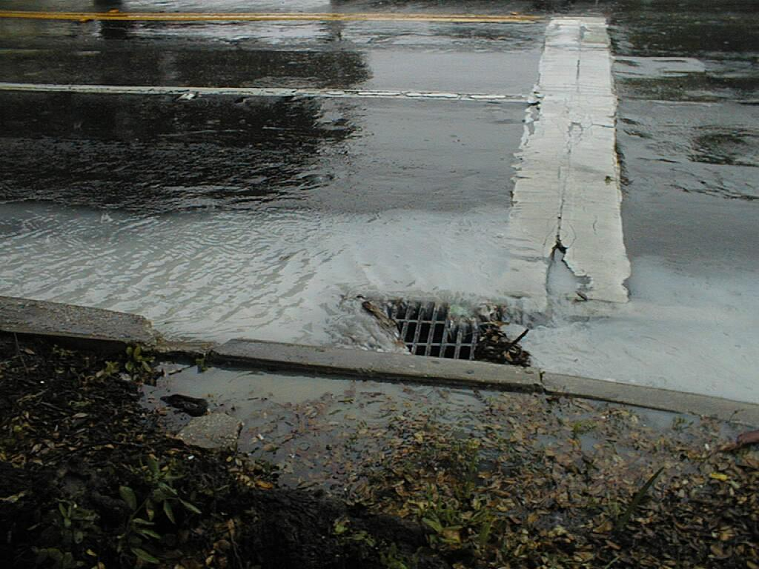
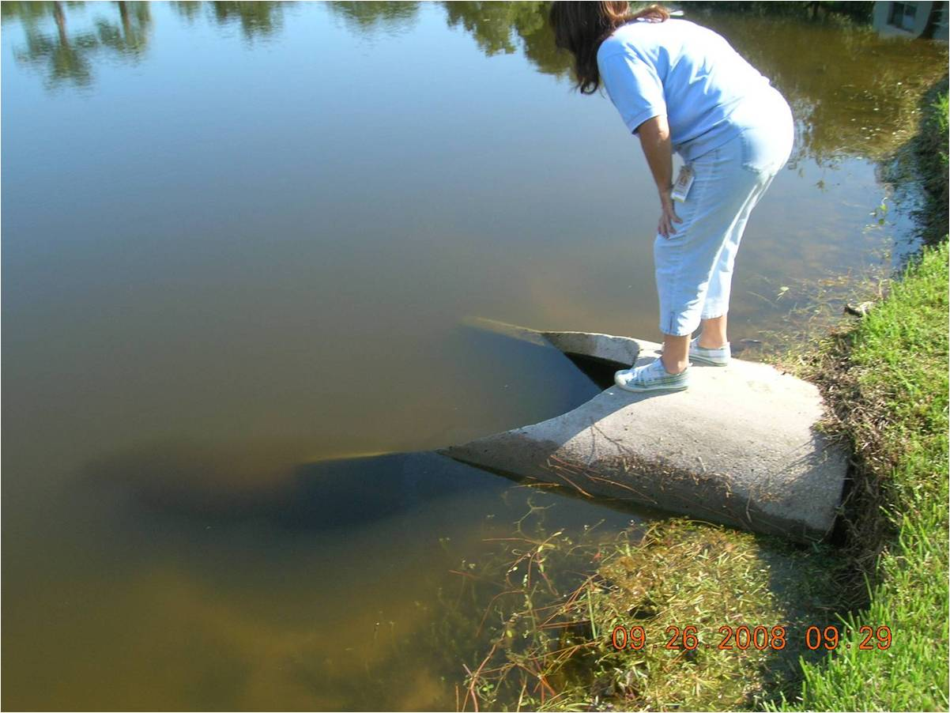
Reduce Rain Water Runoff
For example:
20
Rain Barrels
1400 gallons/
year
X
= 28,000 gallons/
year saved!!
Notes:
…All of these pollutants get carried away to the storm drain system which discharges directly to our rivers and streams. When you harvest rain water in your barrel you are reducing the amount of rain water that ends up on the road and in the storm drain system.
Less rain water runoff means less pollution and less flooding in our lakes rivers and streams.
For example:
If 10 of us installed rain barrels at home then that’s 14,000 gallons of water we are preventing from flooding our rivers and streams.

Slide 17
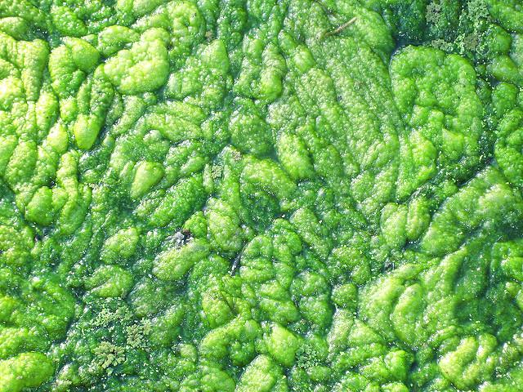
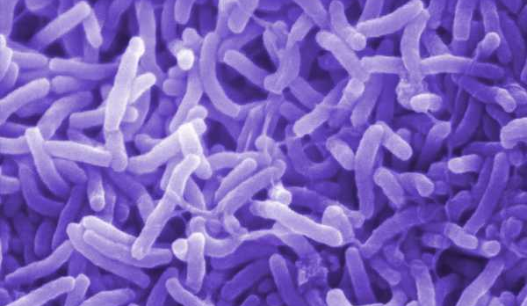
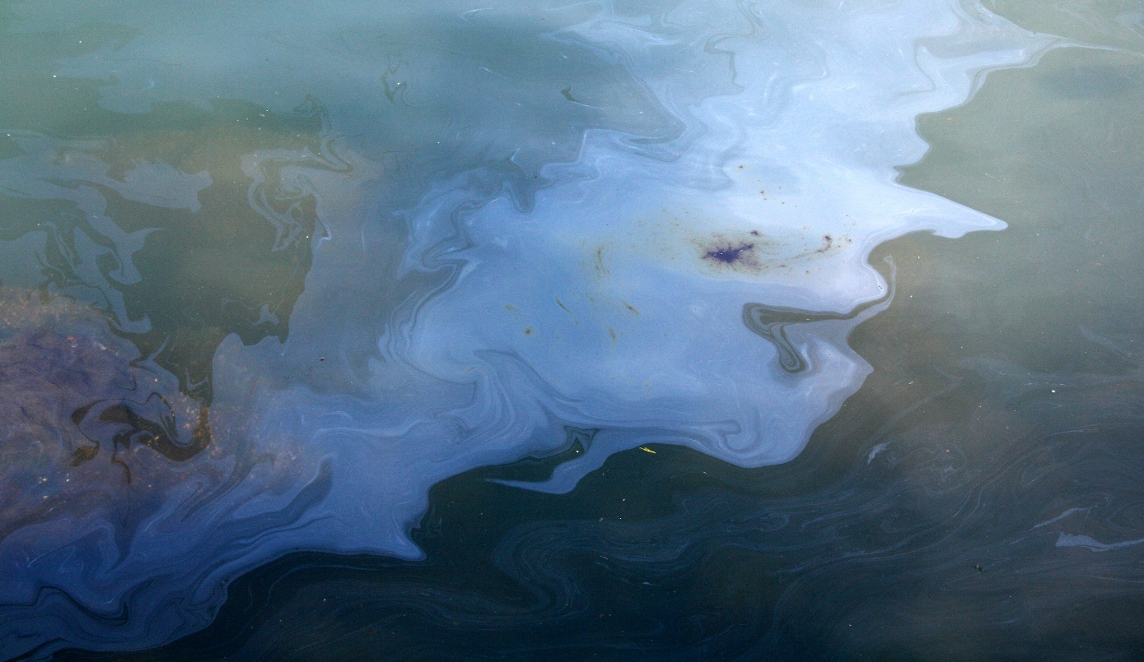
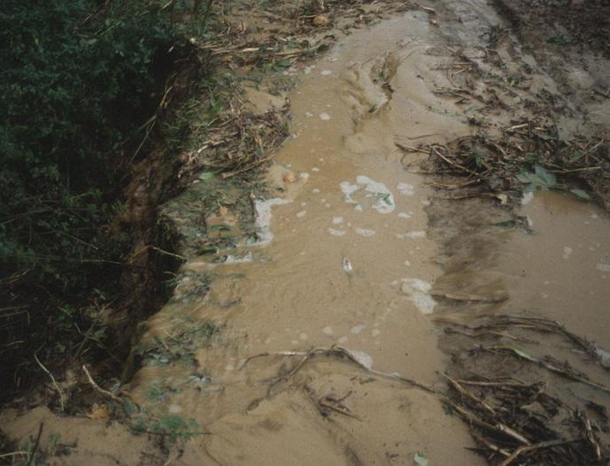
Notes:
The presence of excessive pollutants in our water bodies can cause all sorts of harm
For example, fertilizers can increase the amount of nitrogen and phosphorus deposited into streams, which can lead to harmful algal blooms
Also, motor oil, pesticides and human waste contain chemicals and bacteria that makes the water unsafe for wildlife to drink or live in

Slide 18
Notes:
Non-point source pollution is a significant problem because it is caused by activities that people do every day without realizing their harmful effects
A farmer could put down fertilizer, forgetting that it’ll rain later in the day.
Someone forgot a doggy bag and didn’t pick up after their dog
A car is leaking along the highway
A construction site could be digging up dirt and not putting it in a place to contain it
All of these contaminants accumulate and wash into our water bodies when it rains

Slide 19
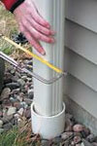
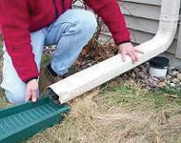
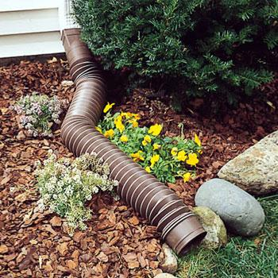
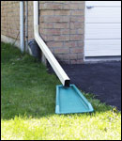
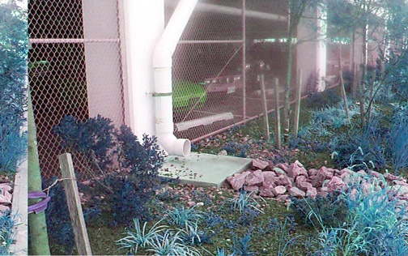
What are some other ways you can do your part?
Downspout Disconnection/Redirection
Notes:
The easiest and cheapest:
i. Assess your downspouts and disconnect them or redirect them to pervious areas so that rain water from your roof infiltrates into the ground
ii. Use flexi-spouts to redirect the water away from your driveway or pathways.
iii. They should be extended to move the water away from your home and basement
iv. Flexi spouts and downspout attachments are very inexpensive and sold at local hardware stores
v. Add a splash guard to spread out the water evenly and prevent the soil from eroding
vi. If you have a basement the downspouts should be extended 6 feet from the house. For a crawl space they should be extended 2 feet from the house

Slide 20
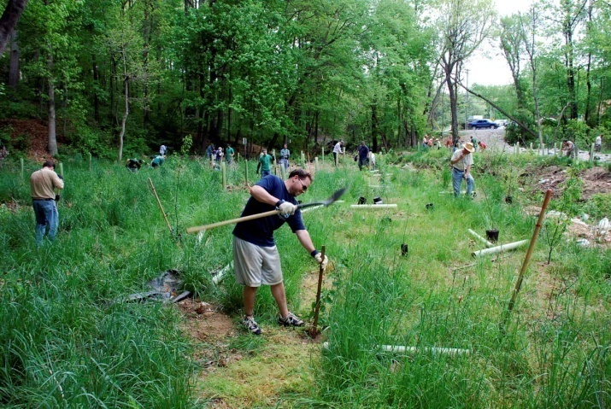
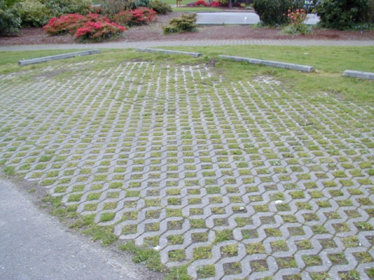
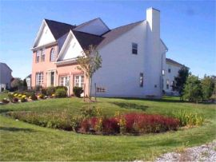
What are some other ways you can do your part?
Plant Trees
Install Porous Pavers
Install Rain Gardens
Photo Credit: Karen Firehock & Dave Hirschaman
Notes:
Some more things you can do:
i. Plant trees – helps to create a riparian buffer and leaves and branches intercept rain water
ii. Reduce the number of hard surfaces on your property and replace with mulch, bricks, gravel, or porous pavement gravel so water can soak into the ground
iii. Install a rain garden which is a specially designed garden that infiltrates rain water into the ground and removes pollutants
iv. Currently landscapers throughout New Jersey are being certified by the Rutgers Water Resource Program to install Rain Gardens.

Slide 21
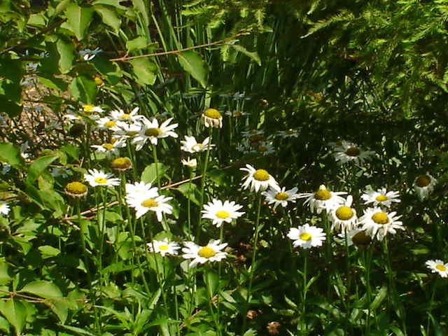
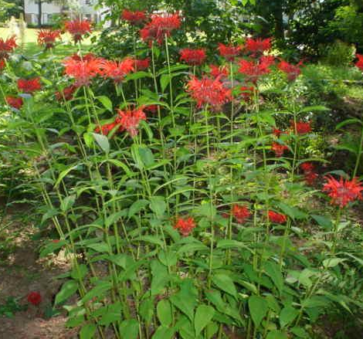
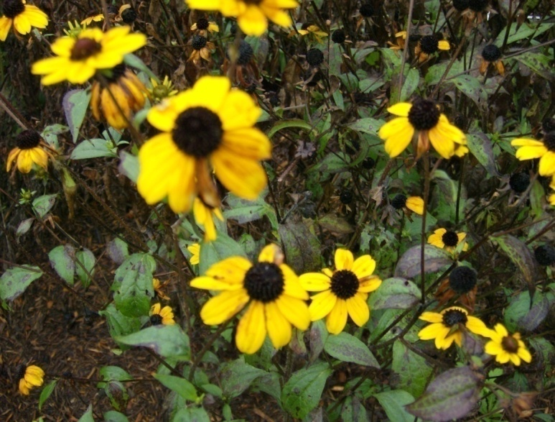
Other rain barrel benefits
Your garden will love it
No salts or chemicals, slightly acidic pH
Notes:
Rain barrels have a lot of benefits other than controlling flooding and pollution
You can use water collected in the barrels to water your plants
Rainwater has no added chemicals, is usually soft and free of dissolved minerals (Water that is "softened" with chemicals is bad for plants due to salts that are dissolved in the water. The salts alter the osmotic pressure plants rely on to regulate their water needs)
Rain water is slightly acidic which is excellent for uptake of nutrients by plants

Slide 22
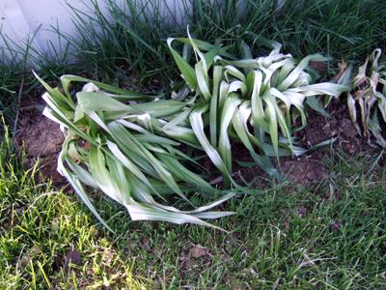
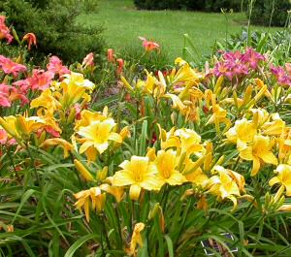
Other rain barrel benefits
Protect valuable landscape during
times of drought
No Rain Barrel With Rain Barrel
Notes:
When there is a period of drought harvested rainwater can be especially beneficial to your plants because you can continue to provide them with the water they need to survive
Dead plant (daylilies) photo from: http://gardendesk.typepad.com/.a/6a00e54efed4088834011279151b7228a4-pi
Live plant (daylilies) photo from: http://www.backyardwisdom.info/blogarchives/DividedDaylilies.jpg

Slide 23
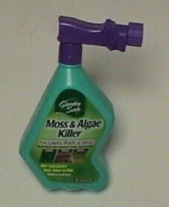
Rain Barrel Use and Care
Do not use rain barrel water for cooking or drinking
Do not collect rain water if you
have used a moss-killer on your roof
Photo by: BugSpray.com
Notes:
Do not drink or cook with the water because it may contain bacteria or other chemicals from your roof
Also do not collect rain water if you use a moss killer on your roof because if you use this water on your garden it could kill your plants
You should wait three months after applying moss killer before collecting rainwater in your barrel

Slide 24
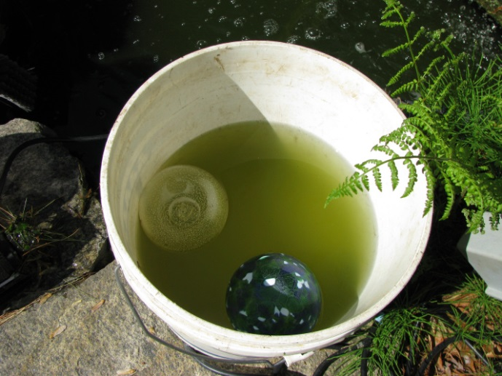
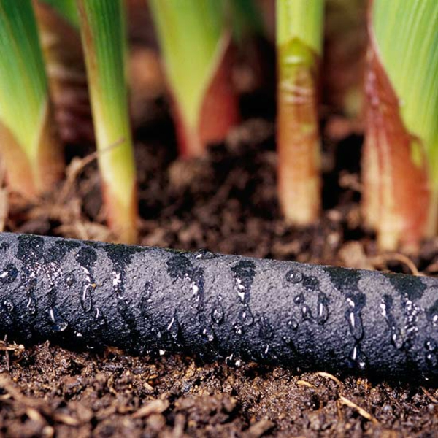
Use of the Water
Use water within a week or two to discourage algae growth.
Use water before next rain is expected or connect to soaker hose in garden.
Notes:
After you have started using your barrel you want to manage it wisely
You need to have some turnover of water in your barrel. Two week turnover is recommended. Algae growth might develop especially if it sits in a sunny location
A soaker hose can be connected to the rain barrel faucet and discharged slowly to a garden area

Slide 25
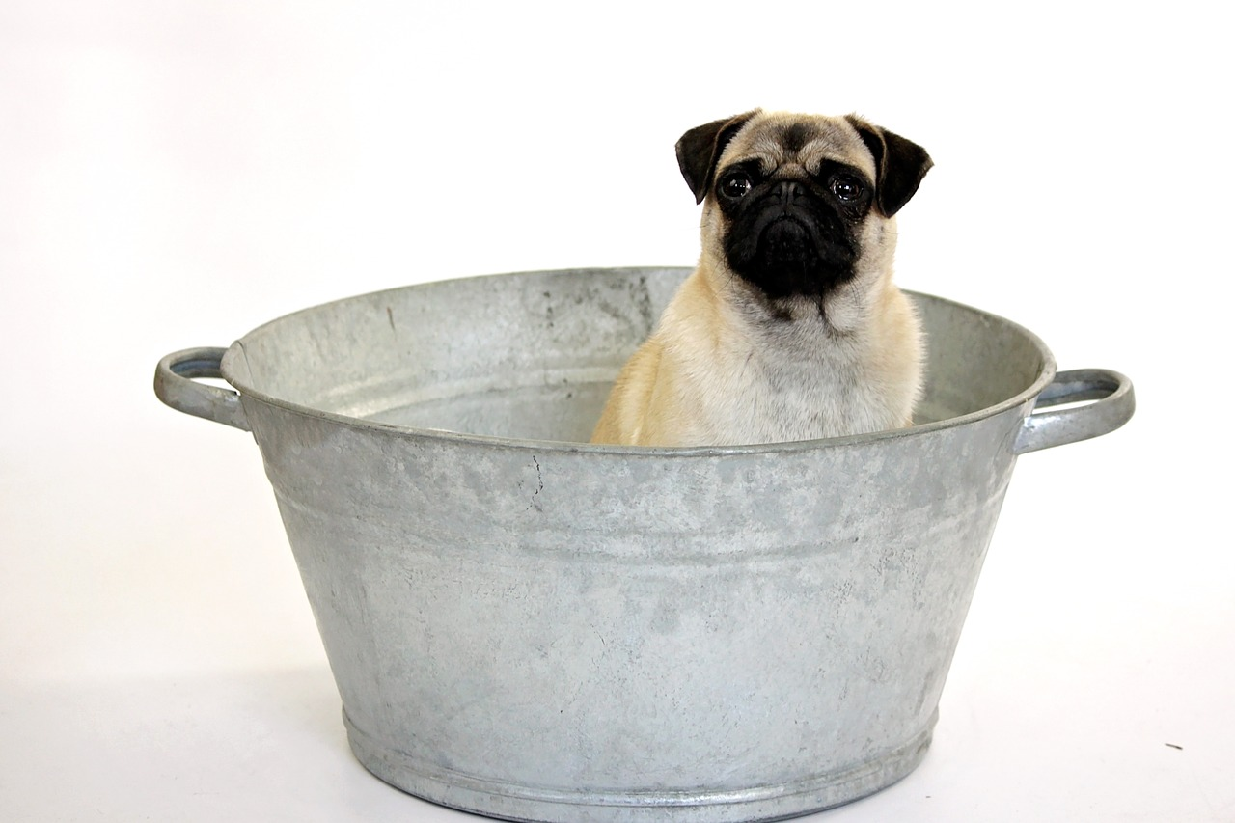
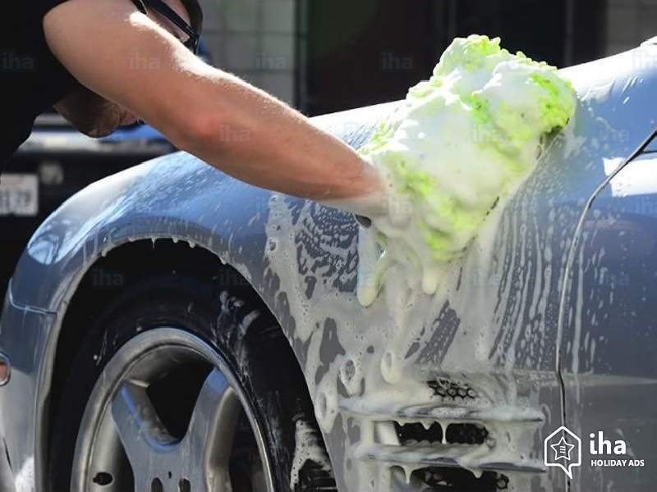
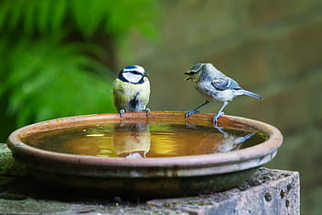
Use of the Water
In addition to watering gardens:
•Wash the dog, car or muddy feet
•Use in toilet tanks when water mains break or well pump isn’t working
•Use in birdbaths
Notes:
In addition to watering your plants you can use harvested water to:
Wash your dog, car or muddy feet
Use it in the toilet tank when water main breaks or pump is not working well
Use in birdbaths

Slide 26
Building your Rain Barrel!
Notes:
Maggie begins

Slide 27
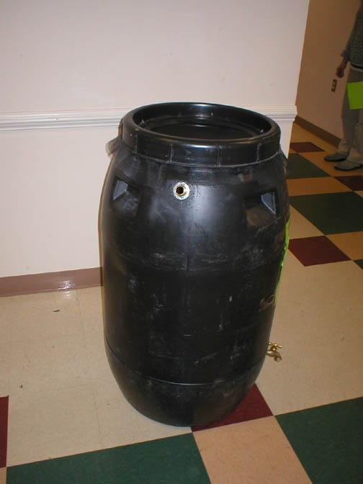
Screen
Overflow
Faucet
Notes:
Building a rain barrel involves installing a faucet at the bottom, and an overflow and screen at the top.
Photograph of rain barrel by Clean Virginia Waterways

Slide 28
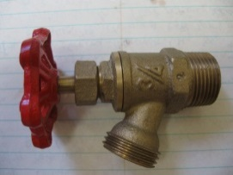
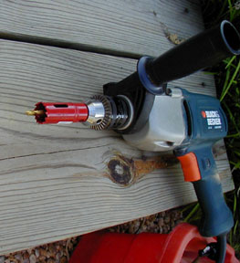
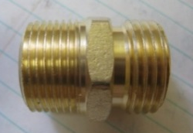
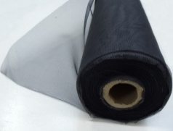
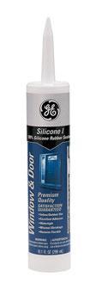
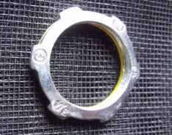
Supplies and Tools
Brass Faucet
Hose adapter (male, ¾”)
2 Locknuts, ¾ in
Plumbers tape
Bungee Cords
Power drill with 1 in. hole saw
Fiberglass screen
Silicone caulk
Pliers
Gloves for spreading caulk
Notes:
These are the supplies and tools you will need to construct a rain barrel.
Brass Faucet for water access.
Hose adaptor for overflow.
Locknuts for inside overflow and faucet.
Fiberglass screen for keeping mosquitoes out.
Bungee Cords to hold the screen down.
Plumbers tape and caulk for creating a seal around faucet and hose adaptor.
Drill for cutting holes for overflow and faucet as well as jigsaw drill… which is already done for us.
Pliers for installing hose adaptor.
Gloves for spreading caulk.
It’s also helpful to have paper towels on hand.

Slide 29
Safety
Safety glasses are required to be worn when:
Using a power drill
Steadying a barrel for
someone drilling.
Notes:
The Visions & Pathways participants won’t be using tools but it’s helpful to go over the cutting part.
Note to speaker: If you are helping a participant drill holes in a barrel you both must wear safety glasses. Make sure to have a first aid kit with you. Accidents do happen.

Slide 30
Use jigsaw to cut opening
Notes:
Use a jig saw to cut a hole in top of barrel for the inlet. Make sure it is large enough for the basket you are using yet small enough so the top of your basket does not fall through. This should provide an opening to fit the device without gaps so mosquitoes can’t get in the barrel.

Slide 31
Drill hole for faucet and overflow
Drill where barrel is flat, not near a seam.
Faucet – Drill about 5 inches from base.
Overflow – Do not drill your hole on the back.
Notes:
If you are drilling hole in the base, put it as low as possible so you get as much water out of the barrel as you can, but should be where the barrel is flat not tapered. Do not drill near a seam.
Note to speaker (if using blue barrels with the two bung holes, the faucet should be drilled as low on the barrel as the participant can reach inside to screw on the locknut.)
Photograph of rain barrel by Rutgers Cooperative Extension

Slide 32
Overflow
Think before you drill!
What side do you want your overflow on?
Notes:
Now for the overflow.
DON’T put overflow on back of barrel which will be up against the house.

Slide 33
Put thread seal tape on faucet
Put silicone caulk over faucet threads
Notes:
Creating a good seal is very important for making sure the barrel does not leak. Make sure to put enough caulk on outside of barrel and inside of barrel around faucet.
Photographs of faucets by Mike Haberland, RCE of Camden and Burlington Counties

Slide 34
Screw faucet in
Keep the faucet straight as you screw it in
Notes:
Keep the faucet STRAIGHT as you screw it in. This is harder than it looks. Wearing gloves helps. Have a helper to hold barrel still, and watch to see that the faucet is going in straight.

Slide 35
Sealing lock nut on other end of faucet
But how????

Slide 36
Screw sealing lock nut on other end of faucet
Flashlight and paper
towels are useful

Slide 37
Caulk around inside and outside of faucet
Faucet is complete!

Slide 38
Put thread seal tape on hose adapter
Caulk around hose
adapter threads

Slide 39
Screw in overflow
Will need to use pliers/wrench
Screw lock nut on the inside of overflow fitting.
Note that some lock nuts are concaved/curved – the “teeth” should align with the barrel’s surface
Notes:
Photograph of rain barrel by Michele Bakacs, RCE of Middlesex & Union Counties

Slide 40
Caulk around inside and outside
Overflow is done!
Notes:
Photograph of rain barrel by Michele Bakacs, RCE of Middlesex & Union Counties

Slide 41
Cut fiber glass screen to desired length
Notes:
Install screen:
If using a screw top barrel, simply unscrew the lid, have a helper hold a 2 ft x 2 ft piece of window screen over top of the barrel and pull taught. Then screw the lid down on top of the screen. Trim excess screen as desired.
It is also possible to simply cover over the entire top of the closed-top rain barrel with either fiberglass or aluminum window screen that is 36 x 36 inches. Use a 48-inch bungee cord to secure the screen. Trim excess screen as desired.
If using a basket to insert into the top of the closed top barrel, simply cover the entire basket with a sheet of fiber-glass window screen large enough to allow it to be tied at bottom using a wire tie, and seat the basket in the inlet opening. A couple of screws will hold it in place.

Slide 42
Installing your Rain Barrel!
Notes:
Sam begins

Slide 43
1a. Prepare the Area Under Your Downspout- Make it flat!
Level the dirt under your downspout
Add some sand, gravel or crushed stone
Notes:
You want your barrel to be level so that it does not topple over when it’s full – safety! It could possibly hurt someone or damage your plants.

Slide 44
1b. Prepare the Area Under Your Downspout- Raise it up!
Full barrel
is heavy –
440 lbs or 55 gallons!
Rain barrel needs to be higher than ground level
Create a platform using bricks, cinder blocks, or pressure treated wood
Notes:
Barrels are about 52 gallons. 52 x 8 pounds per gallon = 416 pounds!
Left photograph by Clean Virginia Waterways
Right photograph by Michele Bakacs, RCE of Middlesex & Union Counties

Slide 45
2. Cut Off Part of Downspout - Redirect the Flow!
Cut Here
Hacksaw
Measure twice, cut once!
Use hacksaw or sabresaw
Notes:
For this part you’ll be cutting your downspout so you can place a curved downspout end piece to have the water flow into the barrel.
Notice in the picture on the left the mark is being made below the top of the elbow since he elbow will be inserted up and over the downspout.
You don’t want to cut off too much so measure twice, cut once with a hacksaw or sabresaw.
You’ll also want to put a back plate behind the downspout so you’re not cutting into your house.

Slide 46
3. Put the Rain Barrel in Place and Re-attach the Curved Downspout End Piece- Aim the flow!
Notes:
After cutting the downspout, place your rain barrel under the downspout and attach the curved downspout end piece over the downspout. If it doesn’t fit well you can use pliers to bend the downspout edges so the elbow piece can slip over it.

Slide 47
4. Re-attach the Downspout Strap- Secure the flow!
Notes:
Then you attached the downspout strap so the elbow piece is secured in place.

Slide 48
5. Attach Garden Hose to Overflow- Use the Overflow!
Notes:
You don’t want to install your rain barrel without a garden hose. The open overflow hole will allow mosquitoes in.
Direct your garden hose to a garden area, lawn, or some distant runoff area away from the house.

Slide 49
7. Add Mosquito Dunk and Vegetable Oil- Protect the Water!
2 Tablespoons of vegetable oil brakes the surface tension so mosquitoes cannot land on the water
Notes:
Mosquito dunk prevents mosquito larvae. Available in local hardware stores and home centers.
2 Tablespoons of vegetable oil brakes the surface tension so mosquitoes cannot land on the water.

Slide 50
Congratulations! You’re Done!
Notes:
Photograph by Michele Bakacs, RCE of Middlesex & Union Counties

Slide 51
Some Tips
Increase storage capacity by using
rain barrels in a series.
Modify the installation design for your needs.
Paint or landscape around your barrel.
Notes:
I know that these barrels will be an addition to the rain barrel you currently have, so the school will be connecting these barrels to the current one!
There are many ways you could hook one barrel to another. Here, we used some plastic tubing and hose clamps.

Slide 52
How to Paint Rain Barrels:
Remove waxy outer coating with sandpaper/abrasive pad.
Spray/ paint primer that sticks to plastic (label should say so).
Decorate with acrylic paint or spray paint that adheres to plastic.
Finish with polyurethane/ enamel spray coating for weather protection

Slide 53
Care of Your Barrel
Keep screen on top and a garden hose attached to the overflow to prevent mosquitoes – change screen every 2 years
Remove debris from screen after storms
Notes:
General maintenance.

Slide 54
Care of Your Barrel for Winter
Disconnect the barrel in winter – store inside or outside upside down with a cover
Use a flexispout to divert winter water to pervious surface.
Clean out with long brush and water.
Dilute bleach solution (~3%)

Slide 55
Credits
Rutgers Cooperative Extension
NJDEP Division of Water Supply – NJ Water Savers Program
Arlington County Department of Environmental Services
Clean Virginia Waterways
Ocean Spray
Notes:
Credits: All of these organizations contributed to the development of this presentation.

